Slide 1

GPIO Programming
Insyde Software March 2021

Slide 2
Copyright 2021 Insyde Software Corp., All Rights Reserved.
No part of this publication may be reproduced, transmitted, transcribed, stored in a retrieval system, or translated into any language or computer language, in any form, or by any means, electronic, mechanical, magnetic, optical, chemical, manual or otherwise, without the prior written permission of Insyde Software Corp.
Disclaimer
Insyde Software Corp. (“Insyde”), provides this document and the programs "as is" without warranty of any kind, either expressed or implied, including, but not limited to, the implied warranties of merchantability or fitness for a particular purpose.
This document may contain technical inaccuracies or typographical errors. Changes are periodically made to the information herein; these changes will be incorporated in future revisions of this document. Insyde is under no obligation to notify any person of the changes. Some code names featured in this document are used to identify products that are in development and not yet publicly announced for release. Insyde is not obligated for its accuracy or completeness.
This document may contain third party’s information, features, schedules, code names, and product names, which are based on Insyde’s interpretation available as of the creation of this document and may be changed from time to time. Neither Insyde nor the third party is obligated to notify such change. If you are interested in third party’s information, you may contact the local third party sales office or the local distributor to obtain the latest specifications. All the intellectual property right of any third party information remains to its owner or steward.

Slide 3
Agenda
Goals & Target Audience
Overview
Related Files
Customization Steps
Internal Use

Slide 4
Goals & Target Audience

Slide 5
Goals & Target Audience
Target Audience:
BIOS developers who use InsydeH2O 5.4 (EDK II) to create their firmware products.
Goals:
Know how to program GPIO in InsydeH2O 5.4.
Requirements:
InsydeH2O 5.4 source code
GPIO Schematic

Slide 6
Overview

Slide 7
Overview
There are two methods to set the GPIO settings in build time
PCD (*.GPIO)
UBA
Note: Use gChipsetPkgTokenSpaceGuid.PcdGpioTableSource to decide which one to use.

Slide 8
Overview – PCD (*.gpio)
The Create step uses Excel or H2OIDE to create the basic GPIO setting template for a specific chipset.
The Edit step uses Excel or H2OIDE to control the GPIO Settings by directly editing the GPIO Settings file. There is one GPIO Settings file for each of the boards.
The Build step uses the GenGpioCfg.exe build tool to convert the GPIO setting files into GPIO setting tables that are built into the Flash device image.
The Modify step uses an external tool, such as H2OUVE, to modify the GPIO Settings Table inside the Flash Device Image. This is currently not supported.
The Configure step uses the ProgramGpioPei driver to retrieve the GPIO setting table and configure the GPIO in the components.

Slide 9
GPIO Setting File
Contains GPIO settings for one chip for one board.
Possibly one for each board listed in [SkuIds] in Project.dsc
File name is GPIO_xxxx.gpio, where xxxx matches [SkuId] board name.
File is part of GpioCfgLib in board package, listed in .INF
Formatted using comma-separated values (.csv)
This text format can be read/written by Excel or build tool.
Each row describes one GPIO/pad.
Each column describes one GPIO/pad attribute (input/output, etc.)
EXCEPT: Row 1 lists attribute names, Column 1 lists pad names.
EXCEPT: Row 2 lists valid values for the attributes separated by a ‘;’ character. Empty cells indicate no validation is required.
Each cell contains the text that will be output to the GPIO initialization macro.

Slide 10
GpioCfgLib
Implements GpioCfgLib library class produced by Insyde chipset package.
Library is in the project package.
Header file is in $(CHIPSET_PKG)\Include\Library\GpioCfgLib.h
Contains all the .gpio files.
.gpio files are converted into .c files by GpioConvertCsvToC.exe
.c files are combined as part of the library.
Produces one function: GpioGetCfg().

Slide 11
GpioCfgLib
Includes GPIO header files from reference code.
#include <GpioLib.h>
Defines H2O_GPIO_INIT_STRUCT to be the same as reference code GPIO initialization structure:
typedef PCD_GPIO_CONFIG H2O_GPIO_INIT_STRUCT;
Defines H2O_GPIO_INIT macro to initialize all elements in the structure.
#define H2O_GPIO_INIT(a,b,c,d,e,f,g,h,i,j,k) {a,b,c,d,e,f,g,h,i,j,k}
Defines H2O_GET_BOARD_GPIO macro that verifies that the board is supported and currently executing.

Slide 12
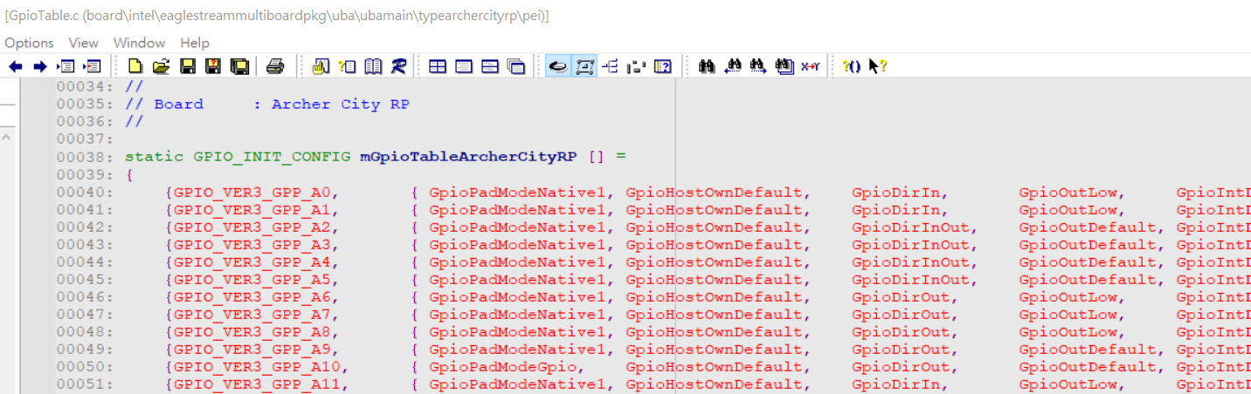
Overview - UBA
The Unified Board Abstraction (UBA) contains the common support for Unified Board Interface that can be shared by multiple boards.
UBA is a database, that contains specific configurations (GPIO…) for different boards in the same BIOS.
Edit it in the C source file directly.

Slide 13
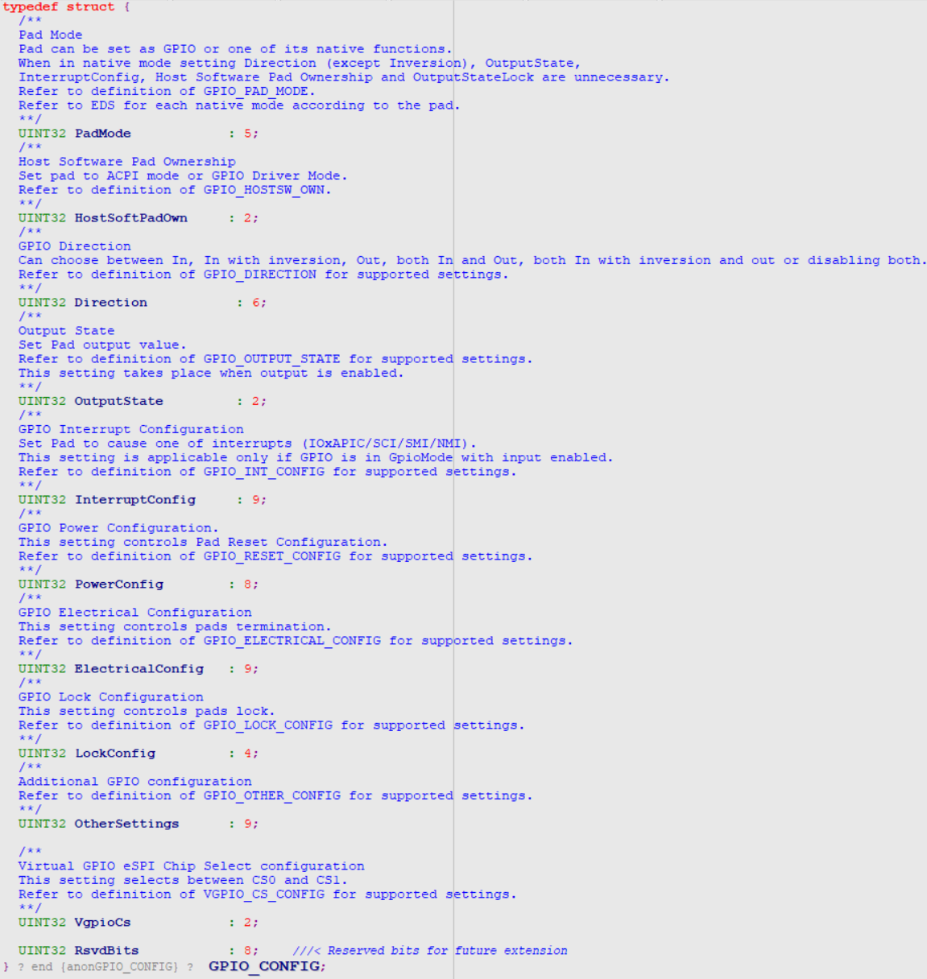


GPIO Structure Define

Slide 14
Programming GPIOs
Insyde chipset package produces driver ProgramGpioPei
Loop through all GPIOs in the configuration.
There are two methods to statically program GPIO
Use GetGpioCfg() in to get GPIO configuration (PCD way)
Handle PCD-controlled chipset feature updates to GPIOs.
Call OemSvcGetGpioTable() to get the GPIO setting.
Use UbaConfigDataBasePpi-> GetData() to get GPIO configuration (Uba way)
Call OemSvcModifyGpioSettingTable to dynamically modify the GPIO setting.
Call GpioConfigurePads() to initialize the GPIO pins.

Slide 15
Related Files

Slide 16
Related Files
Intel/EagleStream/$(CHIPSET_PKG)/Include/ChipsetGpio.h
Intel/EagleStream/ClientOneSiliconPkg/Include/Library/GpioLib.h
Intel/EagleStream/ClientOneSiliconPkg/Include/Library/GpioConfig.h
Board/Intel/$(PROJECT_PKG)/Project.dsc
Board/Intel/$(PROJECT_PKG)/Library/GpioCfgLib/GpioCfgLib.inf
Intel/EagleStream/$(CHIPSET_PKG)/ProgramGpioPei/ProgramGpioPei.inf
Intel/EagleStream/$(CHIPSET_PKG)/ProgramGpioPei/ProgramGpioPei.c
Board/Intel/$(PROJECT_PKG)/Library/PeiOemSvcChipsetLib/OemSvcGetGpioTable.c
Board/Intel/$(PROJECT_PKG)/Library/PeiOemSvcChipsetLib/OemSvcModifyGpioSettingTable.c
Board/Intel/$(PROJECT_PKG)/Uba/UbaMain/$(BOARD_NAME)/Pei/GpioTable.c

Slide 17
ChipsetGpio.h (PCD way)
Provide to Chipset to define GPIO function
typedef struct {
UINT32 GpioPad;
UINT8 PadMode;
UINT8 HostSoftPadOwn;
UINT8 Direction;
UINT8 OutputState;
UINT8 InterruptConfig;
UINT8 PowerConfig;
UINT8 ElectricalConfig;
UINT8 LockConfig;
UINT8 OtherSettings;
UINT8 Rsvdbits;
} PCD_GPIO_CONFIG;

Slide 18
GpioLib.h
GPIO structure define:
typedef struct {
GPIO_PAD GpioPad;
GPIO_CONFIG GpioConfig;
} GPIO_INIT_CONFIG;

Slide 19
GpioConfig.h
GPIO structure define:
typedef UINT32 GPIO_PAD;
typedef struct {
UINT32 PadMode : 5;
UINT32 HostSoftPadOwn : 2;
UINT32 Direction : 6;
UINT32 OutputState : 2;
UINT32 InterruptConfig : 9;
UINT32 PowerConfig : 8;
UINT32 ElectricalConfig : 9;
UINT32 LockConfig : 4;
UINT32 OtherSettings : 9;
UINT32 VgpioCs : 2; UINT32 RsvdBits : 8;
} GPIO_CONFIG;

Slide 20
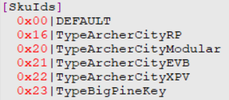
Project.dsc (PCD way)
Define valid SKUID_IDENTIFIER names.
Declare the mapping between library class and instance.
[LibraryClasses.common.PEIM]
GpioCfgLib|$(PROJECT_PKG)/Library/GpioCfgLib/GpioCfgLib.inf

Slide 21
GpioCfgLib.inf (PCD way)
Declare the GPIO setting for specific board.
GpioCfgLib.inf
[Defines]
INF_VERSION = 0x00010005
BASE_NAME = GpioCfgLib
FILE_GUID = c6b57539-2df4-40f7-a1c6-91a2bae359e7
MODULE_TYPE = PEIM
VERSION_STRING = 1.0
LIBRARY_CLASS = GpioCfgLib
[Sources]
# The file name is GPIO_xxxx.gpio, where xxxx matches [Skuids] in Project.dsc
GPIO_DEFAULT.gpio
GPIO_TypeEagleStreamRP.gpio
GetGpioCfg.c
…

Slide 22
ProgramGpioPei.c
Retrieve the GPIO table and configure the GPIO in the component.
EFI_STATUS
ProgramGPIOEntryPoint (
…
)
{
…
if (PcdGet32(PcdGpioTableSource) == GPIO_TABLE_UBA) {
// Retrive GPIO table information from UBA
…
Status = UbaConfigPpi->GetData (UbaConfigPpi, &gPlatformGpioInitDataGuid, GpioDefinitionTable, &TableSize);
…
} else {
// Retrive GPIO table information from PCD (*.gpio)
Status = GetGpioCfg(0, &PcdGpioTable, &GpioTableCount);
…
OemSvcGetGpioTable (&PcdGpioTable, &GpioTableCount);
…
}
Status = OemSvcModifyGpioSettingTable(GpioDefinitionTable);
…
Status = GpioConfigurePads (GpioTableCount, GpioDefinitionTable);
…
return EFI_SUCCESS;
}

Slide 23
OemSvcGetGpioTable.c (PCD way)
Based on the BoardId to get the specific GPIO setting.
EFI_STATUS
OemSvcGetGpioTable (
PCD_GPIO_CONFIG **GpioTable,
UINT32 *PcdGpioTableCount )
{
…
GuidHob = GetFirstGuidHob (&gEfiPlatformInfoGuid);
…
PlatformInfo = GET_GUID_HOB_DATA (GuidHob);
BoardId = PlatformInfo->BoardId;
…
Status = GetGpioCfg((UINT8) BoardId, GpioTable, PcdGpioTableCount);
…
return EFI_MEDIA_CHANGED;
}

Slide 24
ProgramGpioPei (Uba way)
Retrieve the GPIO table from UBA database.
EFI_STATUS
ProgramGPIOEntryPoint (
…
)
{
…
if (PcdGet32(PcdGpioTableSource) == GPIO_TABLE_UBA) {
Status = PeiServicesLocatePpi (&gUbaConfigDatabasePpiGuid, 0, NULL, &UbaConfigPpi);
…
TableSize = PcdGet32 (PcdOemSku_GPIO_TABLE_SIZE); // Retrive size of current Sku GPIO table
…
Status = UbaConfigPpi-> GetData ( // Get GPIO table via Uba ppi UbaConfigPpi,
&gPlatformGpioInitDataGuid,
GpioDefinitiontable,
&TableSize);
…
return EFI_SUCCESS;
}

Slide 25
OemSvcModifyGpioSettingTable.c
Dynamic update before programming GPIO settings.
EFI_STATUS
OemSvcModifyGpioSettingTable (
IN OUT GPIO_INIT_CONFIG *GpioTable
)
{
/*++
Todo:
Add project specific code in here.
--*/
return EFI_UNSUPPORTED;
}

Slide 26
GpioTable.c (Uba way)
GPIO settings:
static GPIO_INIT_CONFIG mGpioTableArcherCityRP [] =
{
{GPIO_VER3_GPP_A0, { GpioPadModeNative1, GpioHostOwnDefault, GpioDirIn, GpioOutLow, GpioIntDis, GpioHostDeepReset, GpioTermNone, GpioLockDefault}},//GPP_A_0_IRQ_LPC_PIRQA_N_ESPI_ALERT0_N
{GPIO_VER3_GPP_A1, { GpioPadModeNative1, GpioHostOwnDefault, GpioDirIn, GpioOutLow, GpioIntDis, GpioHostDeepReset, GpioTermNone, GpioLockDefault}},//GPP_A_1_ESPI_ALERT1_N_LPC_RCIN_N
{GPIO_VER3_GPP_A2, { GpioPadModeNative1, GpioHostOwnDefault, GpioDirInOut, GpioOutDefault, GpioIntDis, GpioHostDeepReset, GpioTermWpu20K, GpioLockDefault}},//GPP_A_2_ESPI_IO0_LPC_LAD0
{GPIO_VER3_GPP_A3, { GpioPadModeNative1, GpioHostOwnDefault, GpioDirInOut, GpioOutDefault, GpioIntDis, GpioHostDeepReset, GpioTermWpu20K, GpioPadConfigLock}},//GPP_A_3_ESPI_IO1_LPC_LAD1
{GPIO_VER3_GPP_A4, { GpioPadModeNative1, GpioHostOwnDefault, GpioDirInOut, GpioOutDefault, GpioIntDis, GpioHostDeepReset, GpioTermWpu20K, GpioPadConfigLock}},//GPP_A_4_ESPI_IO2_LPC_LAD2
{GPIO_VER3_GPP_A5, { GpioPadModeNative1, GpioHostOwnDefault, GpioDirInOut, GpioOutDefault, GpioIntDis, GpioHostDeepReset, GpioTermWpu20K, GpioPadConfigLock}},//GPP_A_5_ESPI_IO3_LPC_LAD3
{GPIO_VER3_GPP_A6, { GpioPadModeNative1, GpioHostOwnDefault, GpioDirOut, GpioOutLow, GpioIntDis, GpioHostDeepReset, GpioTermNone, GpioPadConfigLock}},//GPP_A_6_ESPI_CS0_N_LPC_LFRAME_N
{GPIO_VER3_GPP_A7, { GpioPadModeNative1, GpioHostOwnDefault, GpioDirOut, GpioOutLow, GpioIntDis, GpioHostDeepReset, GpioTermNone, GpioPadConfigLock}},//GPP_A_7_IRQ_LPC_SERIRQ_ESPI_CS1_N
…
}

Slide 27
Customization Steps

Slide 28
Customization Steps
There are two methods to set the GPIO settings in build time
PCD (*.gpio)
Set gChipsetPkgTokenSpaceGuid.PcdGpioTableSource to 0 in Project.dsc
Use H2OIDE to set GPIO settings or directly modify Gpio_XXXXXX.gpio
UBA
Set gChipsetPkgTokenSpaceGuid.PcdGpioTableSource to 1 in Project.dsc
Modify GPIO settings in GpioTable.c.
Dynamic update GPIO default setting for different SKUs
Modify OemSvcModifyGpioSettingTable.c

Slide 29
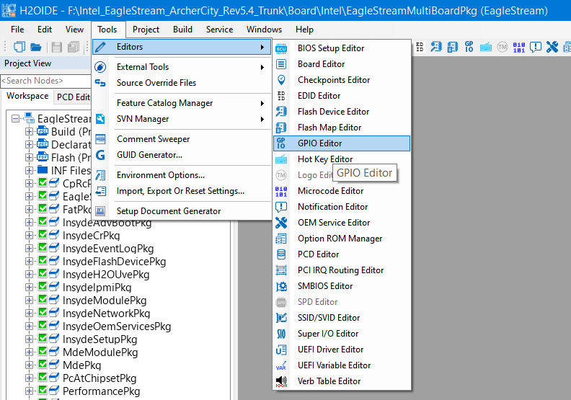
Customization Steps – Via H2OIDE
OpenProject -> Tools -> GPIO Editor

Slide 30
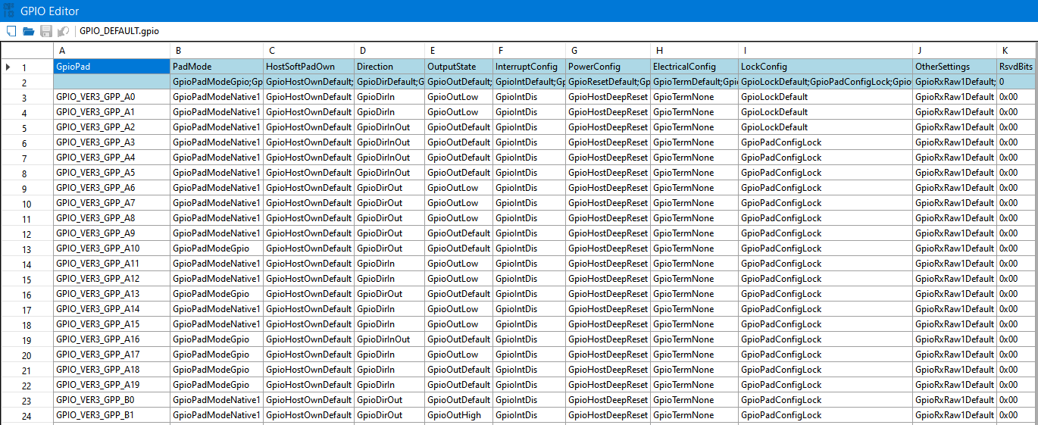
Customization Steps – Via H2OIDE
Window of GPIO Editor

Slide 31
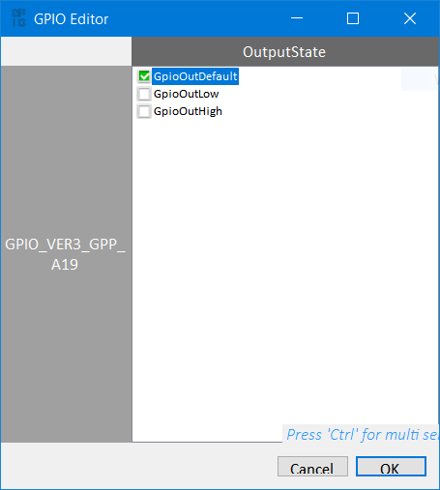
Customization Steps – Via H2OIDE
Double Click the GPIO cell to edit value
Example : GPIO_VER3_GPP_A19.OutputState

Slide 32
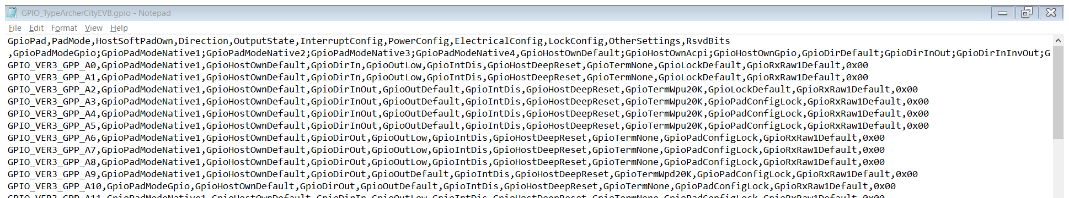
Customization Steps – Directly modify Gpio_XXXXXX.gpio
Open Gpio_XXXXXX.gpio file by editor, which locate at:
Board/Intel/$(PROJECT_PKG)/ Library/GpioCfgLib/
Raw data view:
Example : GPIO_VER3_GPP_A9.OutputState

Slide 33
Thanks!

